Slide 1
Exploring Life Expectancy
Sarah Kelley (SK) Andrea Pope (AP) Dominic Delmolino (DD)

Slide 2
Introduction
Focus: Relationship between life expectancy, life expectancy at age 60 and Healthy life expectancy with:
Access to clean water/sanitation
Aid spending
HIV prevalence
Government spending on health care
Source: World Health Organization http://apps.who.int/gho/data/node.home

Slide 3
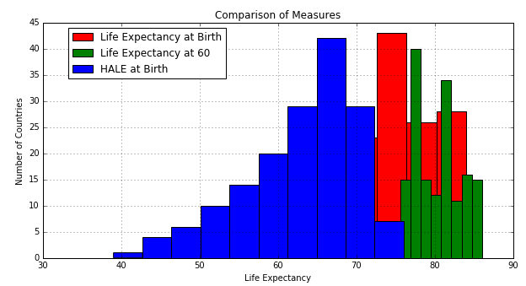
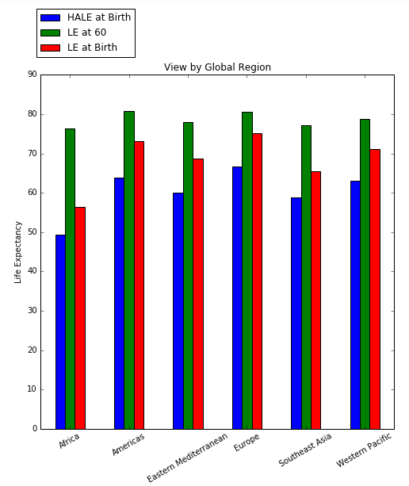
Life Expectancy

Slide 4
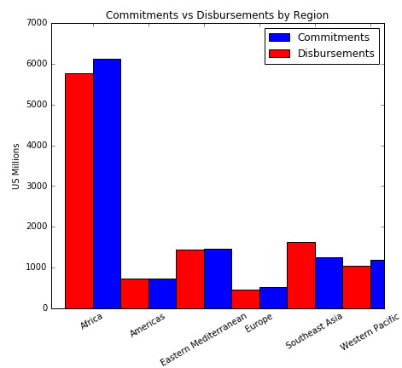
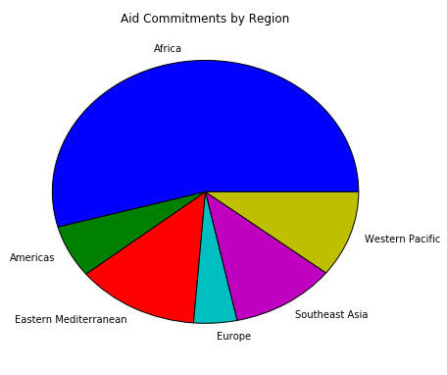
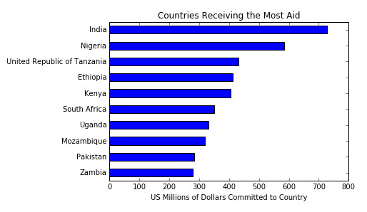
AID

Slide 5
Water and Sanitation

Slide 6
Water and Sanitation

Slide 7
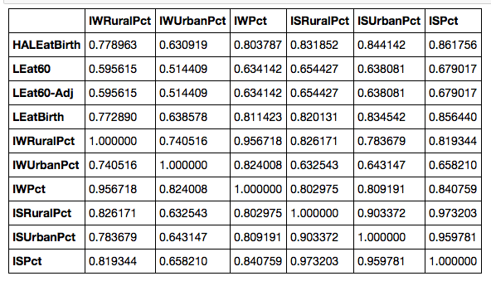
Water and Sanitation

Slide 8
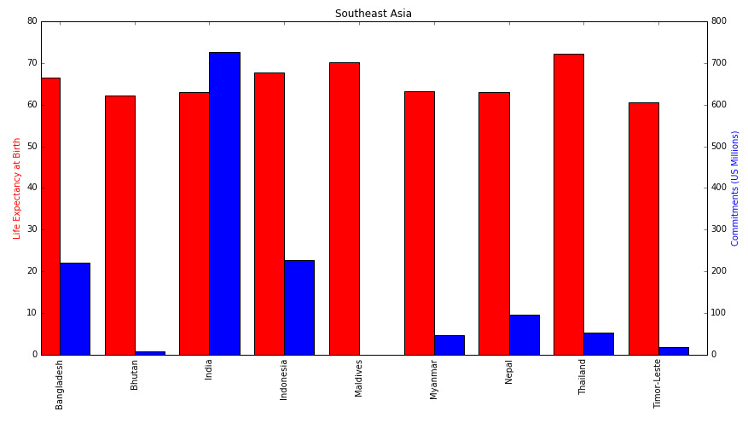
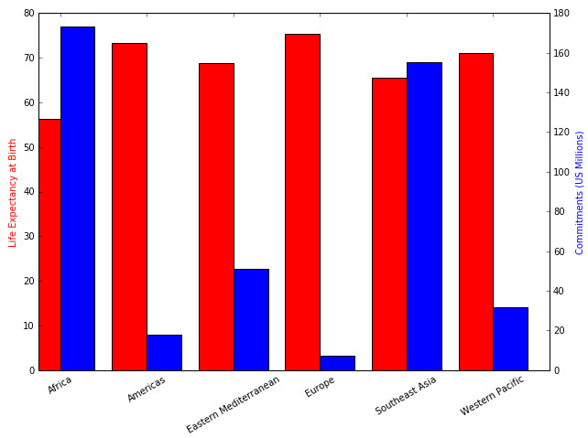
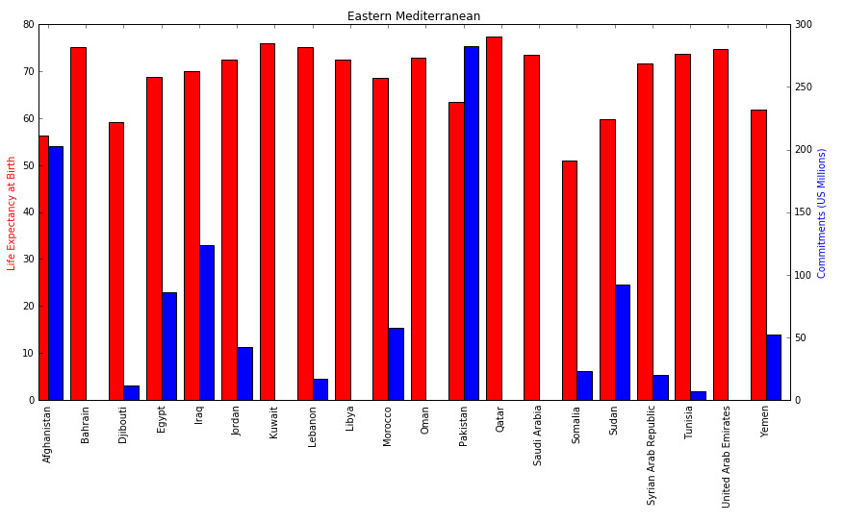
Aid & Life Expectancy

Slide 9
HIV Prevalances

Slide 10
Change in HIV Prevalance

Slide 11
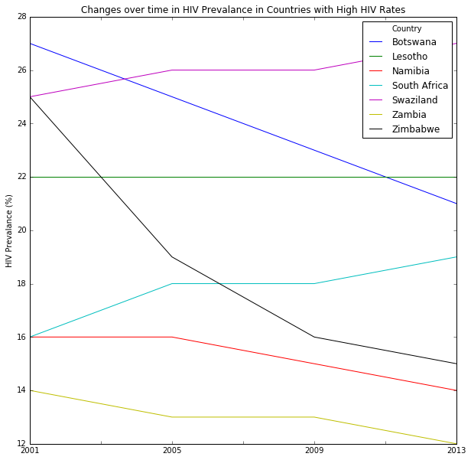
High HIV Countries

Slide 12
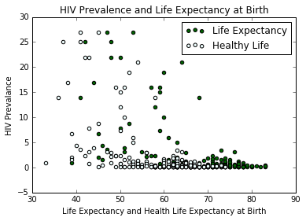
HIV and Life Expectancy

Slide 13
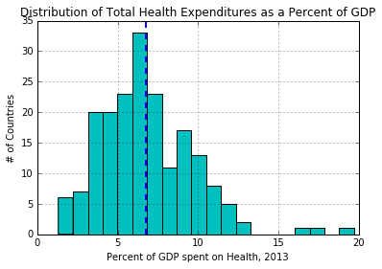
Health Expeditures

Slide 14
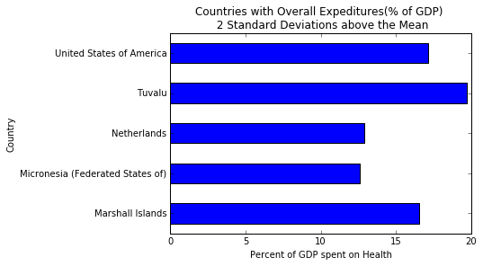
Countries with High Health Expeditures

Slide 15
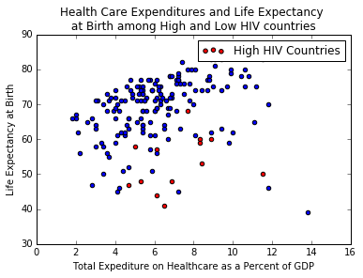
Health Spending, HIV and Life Expectancy

